Slide 1
Automatic Selection of Social Media Responses to News
Date : 2013/10/02
Author : Tadej Stajner, Bart Thomee, Ana-Maria Popescu, Marco Pennacchiotti and Alejandro Jaimes
Source : KDD’13
Advisor : Jia-ling Koh
Speaker : Yi-hsuan Yeh

Slide 2
Outline
Introduction
Method
Experiments
Conclusions

Slide 3
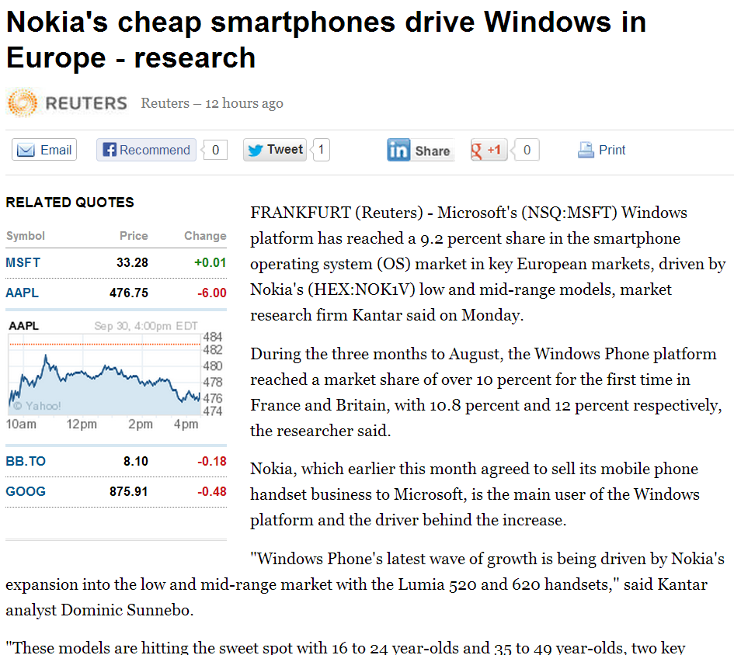
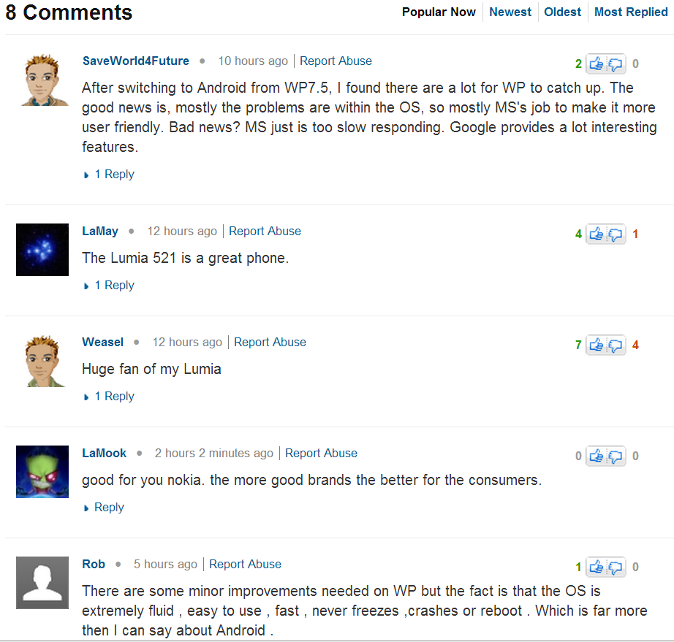
Introduction
Yahoo, Reuters,
New York Times…
Notes:
許多網站有提供使用者新聞資訊的服務，像是yahoo news
而這些網站通常都會在文章下方提供讀者留言的功能
畫面上這是一篇從yahoo news擷取出的新聞，就會像這樣讀者可以留下他對這篇文章或議題的看法。

Slide 4
Introduction
response tweets
Journalist
Reader
useful
Notes:
而有些讀者甚至會把喜歡的新聞文章加上個人的觀點、轉貼到自己的微網誌中，例如：tweeter
這張圖是剛剛那篇文章轉貼到tweeter上的例子。
而這些response對於新聞記者來說是很有用的，他們可以從中得到讀者對於此篇文章的評價 另外，讀者也可以透過其他讀者的回應得到不同的觀點及有趣的想法

Slide 5
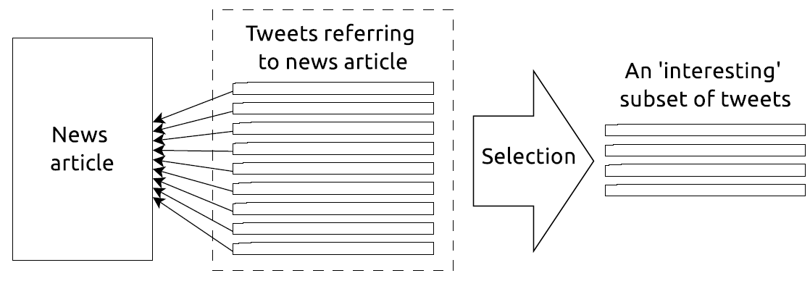
Introduction
Social media message selection problem
Notes:
因此，就有一方面的研究是在做讀者response message的挑選
而他們著重在挑選出較為”interesting”的messages
他會先從tweeter上找出和news article有關的tweets，接著挑選出幾個”interesting”的tweets

Slide 6
Introduction
Quantify the interestingness of a selection of messages is inherently subjective.
Assumption：an interesting response set consists of a diverse set of informative, opinionated and popular messages written to a large extent by authoritative users.
Goal：Solve the social message selection problem for selecting the most interesting messages posted in response to an online news article.

Slide 7
Outline
Introduction
Method
Experiments
Conclusions

Slide 8
Method
Interestingness
5 indicators
Message-level
Informativeness Opinionatedness Popularity Authority
Set-level
Diversity
Utility function： $γ$
Normalized entropy function： $Η_{0}$

Slide 9
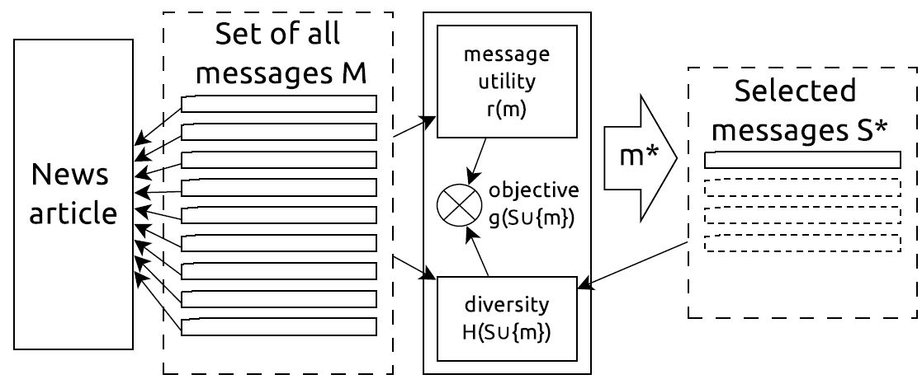
Framework

Slide 10
Individual message scoring : $r\left(m\right)$
Use a supervised model：Support Vector Regression
Input：a tweet
Output：its corresponding score (scaled to interval$\left[0,1\right]$)
Features：
Content feature：interesting, informative and opinioned
Social feature：popularity
User feature：authority
Training：10-fold cross validation

Slide 11
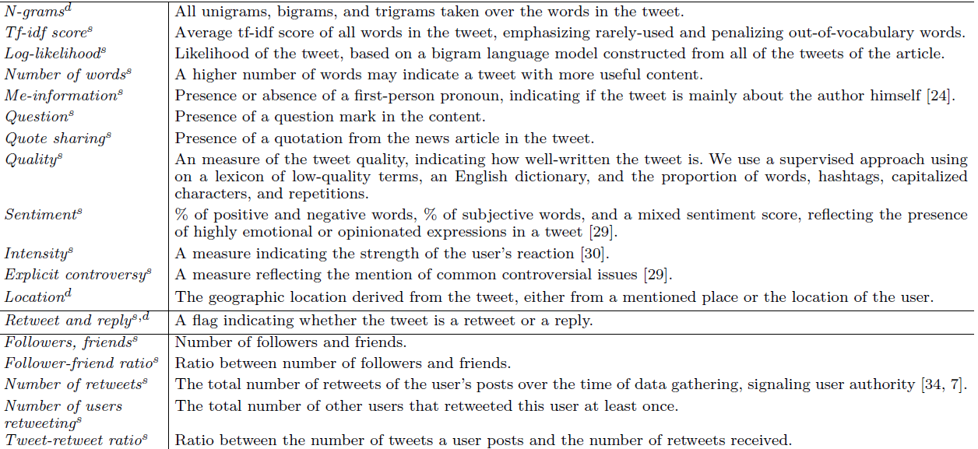

Slide 12
Entropy of message set：$H_{0}$
Treat feature as binary random variable
$S$：a message set
$d$：the number of features
$p\left(f_{i}=1\right)$：the empirical probability that the feature $fi$ has the value of $1$ given all examples in $S$

Slide 13
Feature：N-gram
bigrams and trigrams
Tweet 1：“ I like dogs ”
Tweet 2：” I want to dance”
Round 1
Feature list | i | like | dogs | …
Tweet 1 | 1 | 1 | 1 | …
empirical probability | 1 | 1 | 1 | …
Round 2
Feature list | i | like | dogs | want | to | dance | …
Tweet 1 | 1 | 1 | 1 | 0 | 0 | 0 | …
Tweet 2 | 1 | 0 | 0 | 1 | 1 | 1 | …
empirical probability | 1 | 0.5 | 0.5 | 0.5 | 0.5 | 0.5 | …

Slide 14
Feature： Location
Tweet 1：“I live in Taiwan, not Thailand” (user’s location：Taiwan)
Tweet 2： “I like the food in Taiwan” (user’s location：Japan)
Round 1
Feature list | Taiwan | Thailand
Tweet 1 | 1 | 1
empirical probability | 1 | 1
Round 2
Feature list | Taiwan | Thailand | Japan
Tweet 1 | 1 | 1 | 0
Tweet 2 | 1 | 0 | 1
empirical probability | 1 | 0.5 | 0.5

Slide 15
Example
 | Feature list | Feature1 | Feature 2 | Feature 3
empirical probability | S1 | 1 | 0.8 | 0.2
 | S2 | 1 | 0.8 | 1
$$H\left(S1\right)=−\left[\left(1∗\log{1}\right)+\left(0.8∗\log{0.8}\right)+\left(0.2∗\log{0.2}\right)\right]=−\left(0−0.0775280104−0.13979400086\right)=0.21732201126$$
$$H\left(S2\right)=−\left[\left(1∗\log{1}\right)+\left(0.8∗\log{0.8}\right)+\left(1∗\log{1}\right)\right]=−\left(0−0.0775280104−0\right)=0.0775280104$$
Adding examples to S with different non-zero features from the ones already in S increases entropy.

Slide 16
Objective function
$M$：collection of messages
$S$：a message set
$k$：sample size

Slide 17
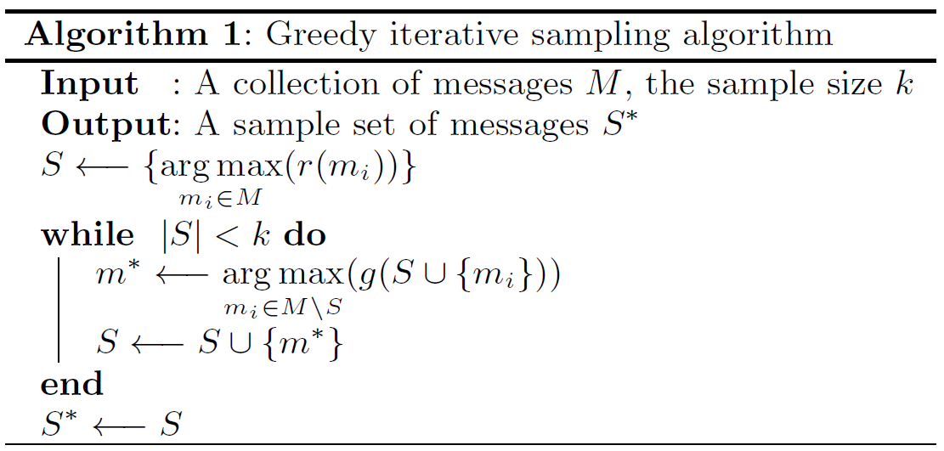
Algorithm

Slide 18
Outline
Introduction
Method
Experiments
Conclusions

Slide 19
Data set
Tweets posted between February 22, 2011 ~ May 31, 2011
Tweets were written in the English language and that included a URL to an article published online by news agencies.
45 news articles
Each news had 100 unique tweets

Slide 20
Gold standard collection
14 annotators
Informative and opinionated indicator：
Interesting indicator：select 10 interesting tweets related to the news article as positive examples
Authority indicator：use user authority and topic authority features
Popularity indicator：use retweet and reply counts
1 | the tweet decidedly does not exhibit the indicator | Negative
2 | the tweet somewhat exhibits the indicator | X
3 | the tweet decidedly exhibits the indicator | Positive

Slide 21
ENTROPY：λ = 0
SVR：λ = 1
SVR_ENTROPY：λ = 0.5

Slide 22
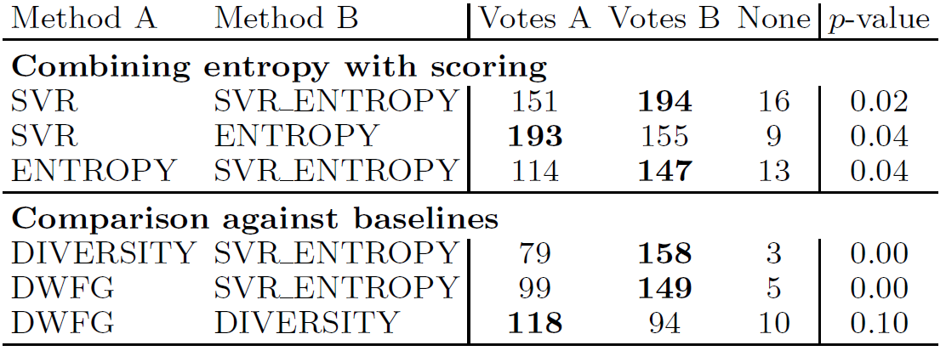
Preference judgment analysis

Slide 23
Outline
Introduction
Method
Experiments
Conclusions

Slide 24
Conclusion
Proposed an optimization-driven method to solve the social message selection problem for selecting the most interesting messages.
Its method considers the intrinsic level of informativeness, opinionatedness, popularity and authority of each message, while simultaneously ensuring the inclusion of diverse messages in the final set.
Future work：incorporating additional message-level or author-level indicators.
Notes:
Future work：增加其他message-level及author-level indicators使結果更好

